Slide 1
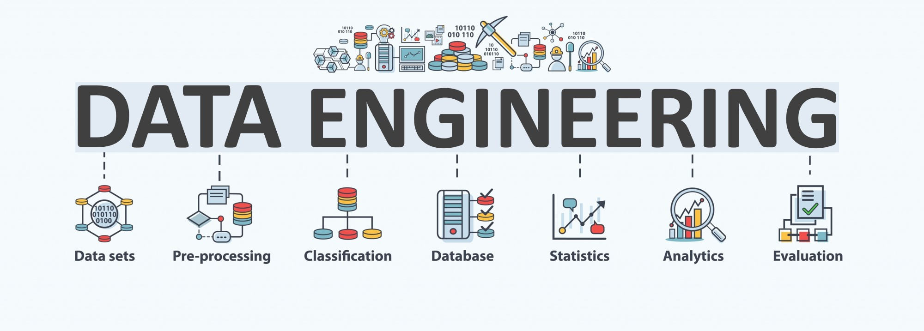

Lecture 6: Data Querying
CS5481 Data Engineering
Instructor: Yifan Zhang

Slide 2
Outline
Overview of data querying
Relational algebra and SQL querying
NoSQL querying

Slide 3
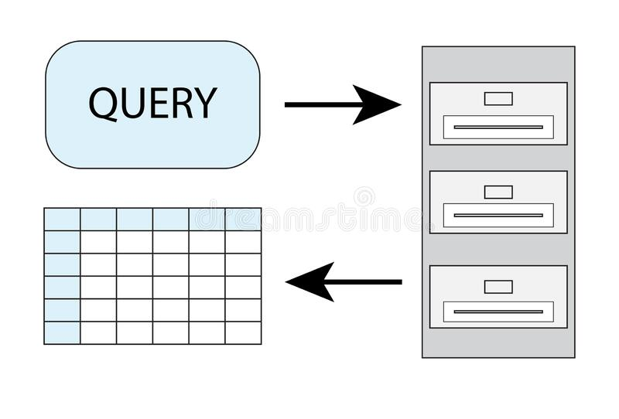
Data querying
A data query is either an action query or a select query.
A select query is one that retrieves data from a database.
An action query asks for additional operations on data, such as insertion, updating, deleting or other forms of data manipulation.

Slide 4

How to perform a query in a database?
1. Choose your data
Determine the data you want to retrieve or update and consider the method you want to use to perform a query
2. Specify data fields
Once you identify the data you want to work with and decide on a method, consider how to perform the query. Choose the data fields you want to include in your query.
3. Assign a table (for relational databases) or a data structure component (for NoSql databases)
When performing a query using a query language, it's important to tell the database where to find the information, so the system understands where to retrieve the data.
4. Filter data
When a database returns a query result, you can choose to filter
the information.

Slide 5
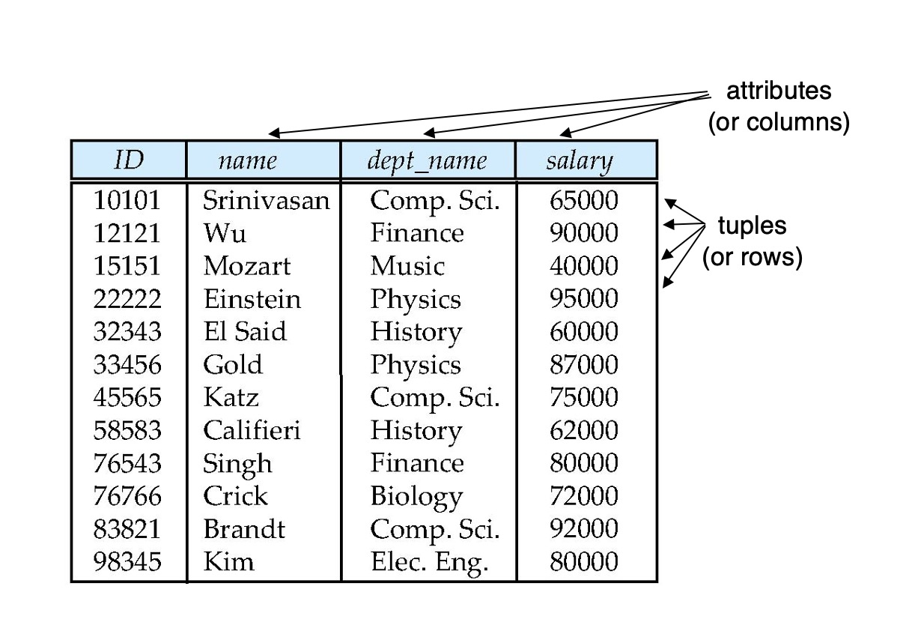
Relational databases and relational algebra
Six basic operators
select: σ
project: ∏
union: ∪
set difference: –
Cartesian product: x
rename: ρ
Additional operations that simplify common queries
set intersection
join
assignment
outer join
Relational databases
Relational algebra

Slide 6
Relational databases – attributes (columns)
The set of allowed values for each attribute is called the domain of the attribute
Attribute values are (normally) required to be atomic; that is, indivisible
The special value null is a member of every domain, indicated that the value is “unknown”

Slide 7
Relational databases – tables
A₁, A₂, …, A_{n} are attributes
R = (A₁, A₂, …, A_{n} ) is a relation schema
Example:
instructor = (ID, name, dept_name, salary)
Formally, given sets D₁, D₂, …. D_{n}, a relation r (a table) is a subset of D₁ x D₂ x … x D_{n} where D_{i} is the domain of attribute A_{i}. Thus, a relation is a set of n-tuples (a₁, a₂, …, a_{n}) where each a_{i} ∈ D_{i}
The current values (relation instance) of a relation are specified by a table
An element t of r is a tuple, represented by a row in a table

Slide 8
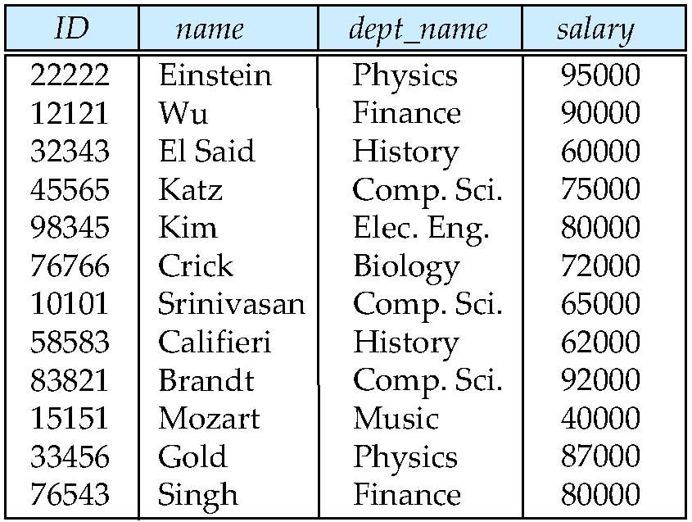
Relational databases – relations are unordered
Order of tuples is irrelevant (tuples may be stored in an arbitrary order)
Example: instructor relation with unordered tuples

Slide 9
Relational databases – multiple relations
A relational database consists of multiple relations
Information about a university is broken up into parts
instructor student advisor
Bad design: univ (instructor-ID, name, dept_name, salary, student_ID, ..) results in
repetition of information (e.g., two students have the same instructor)
the need for null values (e.g., represent an student with no advisor)

Slide 10
Relational databases – keys
Let K ⊆ R
K is a superkey of R if values for K are sufficient to identify a unique tuple of each possible relation r(R)
Example: {ID} and {ID,name} are both superkeys of instructor.
Superkey K is a candidate key if K is minimal Example: {ID} is a candidate key for Instructor
One of the candidate keys is selected to be the primary key.
Foreign key: a set of attributes in a table that refers to the primary key of another table. The foreign key links these two tables.
Example – dept_name in instructor is a foreign key from instructor referencing department

Slide 11
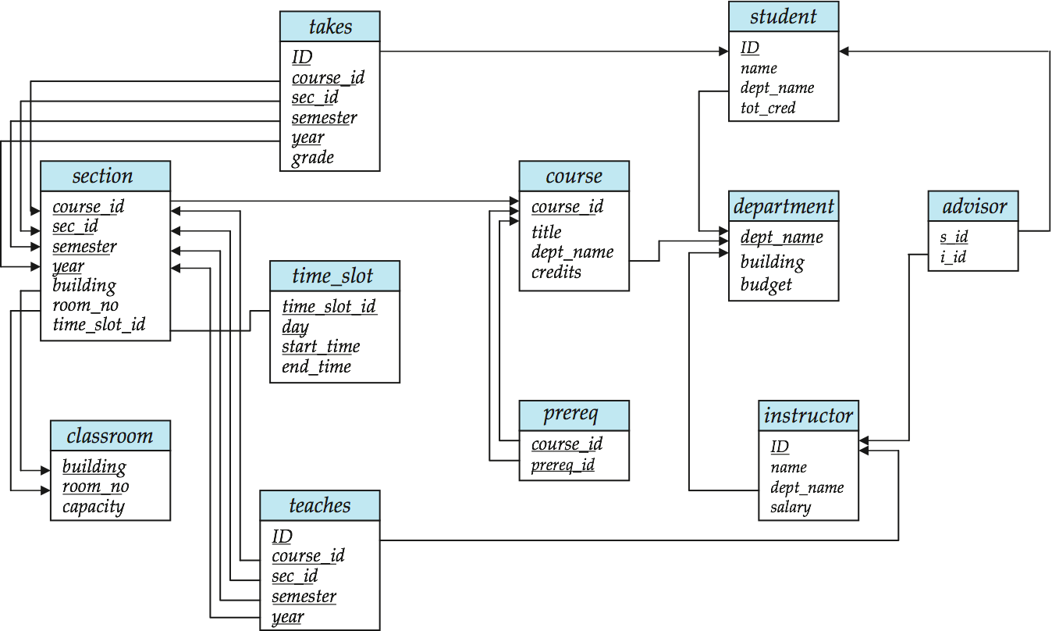
Relational databases – example

Slide 12
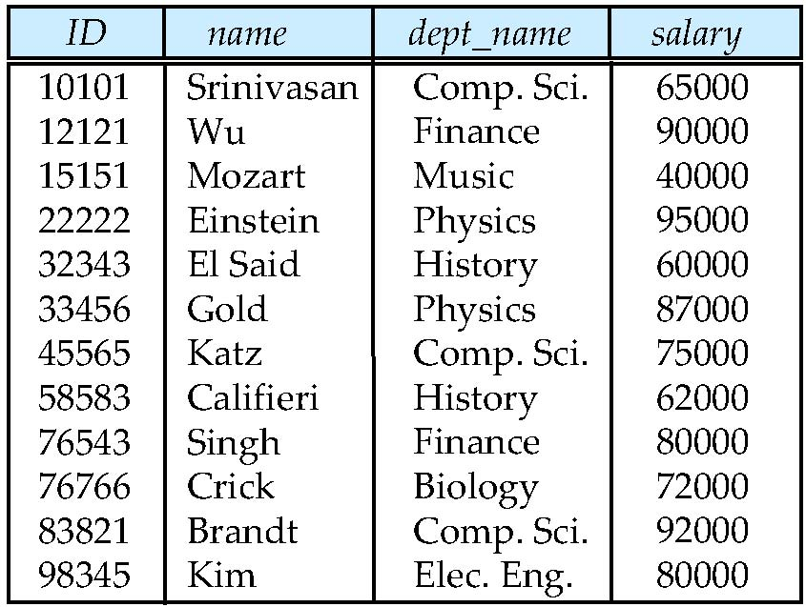
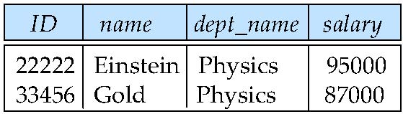
Relational algebra – select (1)
The select operation selects tuples that satisfy a given predicate.
Notation: σ _{p}(r)
p is called the selection predicate (condition)
Example: select those tuples of the instructor relation where the instructor is in the “Physics” department.
Query:
σ _{dept_name=“Physics”} (instructor)
Result:

Slide 13
Relational algebra – select (2)
We allow comparisons using
=, ≠, >, ≥, <, ≤
in the selection predicate.
We can combine several predicates into a larger predicate by using the connectives:
∧ (and), ∨ (or), ¬ (not)
Example: Find the instructors in Physics with a salary greater $90,000, we write:
σ dept_name=“Physics” ∧ salary > 90,000 (instructor)
Then select predicate may include comparisons between two attributes.
Example, find all departments whose name is the same as their building name:
σ _{dept_name=building} (department)

Slide 14
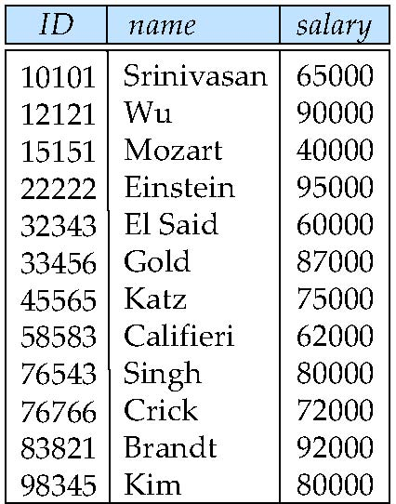
Relational algebra – project
A unary operation that returns its argument relation, with certain attributes left out.
Notation:
∏ _{A1,A2,A3 ….Ak} (r)
where A₁, A₂ are attribute names and r is a relation name.
The result is defined as the relation of k columns obtained by erasing the columns that are not listed
Duplicate rows removed from result, since relations are sets
Example: eliminate the dept_name attribute of instructor
Query: ∏_{ID, name, salary} (instructor)
Result:

Slide 15
Relational algebra - composition of relational operations
The result of a relational-algebra operation is relation and therefore relational-algebra operations can be composed together into a relational-algebra expression.
Consider the query -- Find the names of all instructors in the Physics department.
∏_{name}(σ _{dept_name} _{=“Physics”} (instructor))
Instead of giving the name of a relation as the argument of the projection operation, we give an expression that evaluates to a relation.

Slide 16
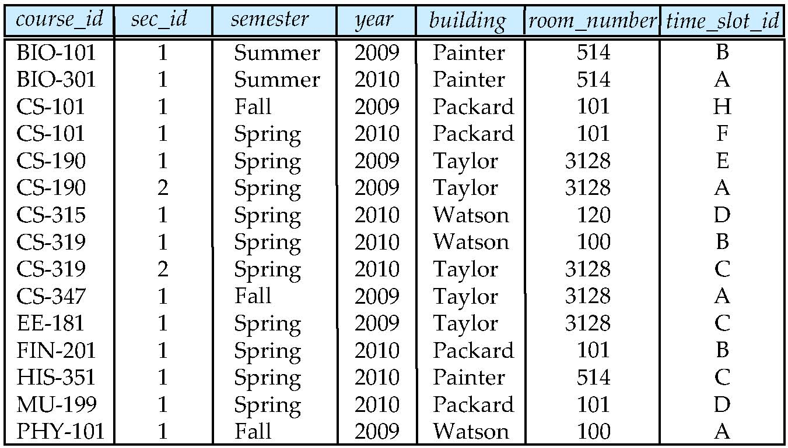
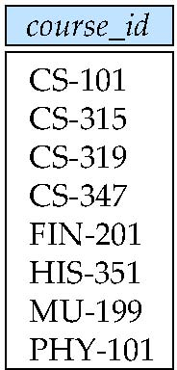
Relational algebra - union
The union operation allows us to combine two relations (union of sets)
Notation: r ∪ s
Output the union of tuples from the two input relations
For r ∪ s to be valid.
1. r, s must have the same arity (same number of attributes)
2. The attribute domains must be compatible (example: 2nd column of r deals with the same type of values as does the 2nd column of s)
Example: to find all courses taught in the Fall 2009 semester, or in the Spring 2010 semester, or in both
Query: ∏_{course_id} (σ _{semester=“Fall” Λ year=2009} (section)) ∪
∏_{course_id} (σ _{semester=“Spring” Λ year=2010} (section))
Result:

Slide 17
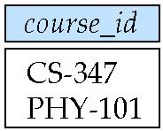
Relational algebra – set difference
The set-difference operation allows us to find tuples that are in one relation but are not in another.
Notation: r – s
Produce a relation containing those tuples in r but not in s
Set differences must be taken between compatible relations.
r and s must have the same arity
attribute domains of r and s must be compatible
Example: to find all courses taught in the Fall 2009 semester, but not in the Spring 2010 semester
Query: ∏_{course_id} (σ _{semester=“Fall” Λ year=2009} (section)) − ∏_{course_id} (σ _{semester=“Spring” Λ year=2010} (section))
Result:

Slide 18
Relational algebra – Cartesian-product (1)
The Cartesian-product operation (denoted by X) allows us to combine information from any two relations.
Notation: r x s
Output all pairs of rows from the two input relations (regardless of whether or not they have the same values on common attributes)
Assume that attributes of r(R) and s(S) are disjoint. (That is, R ∩ S = ∅).
If attributes of r(R) and s(S) are not disjoint, then renaming must be used.

Slide 19
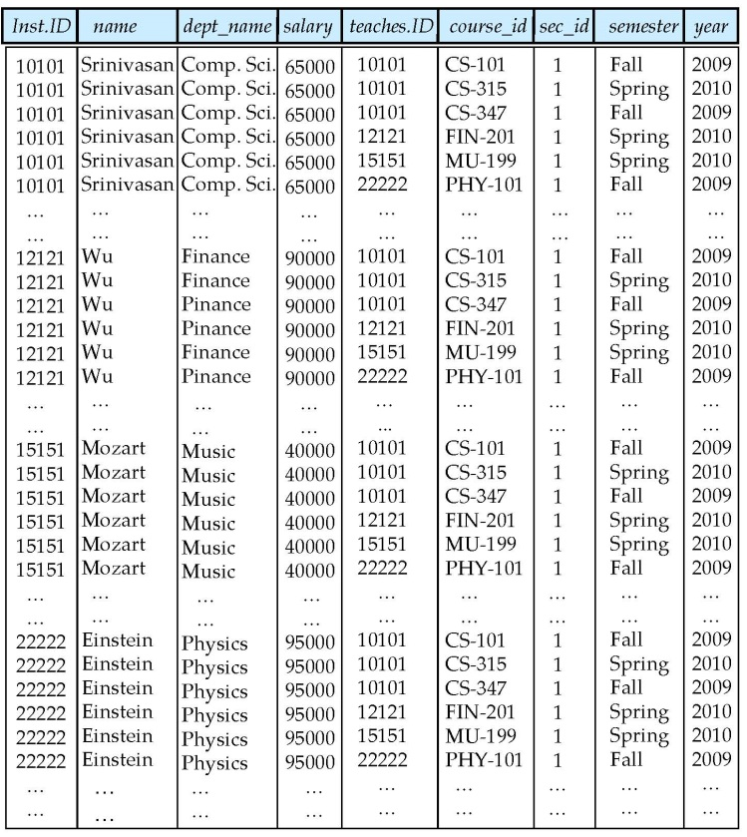
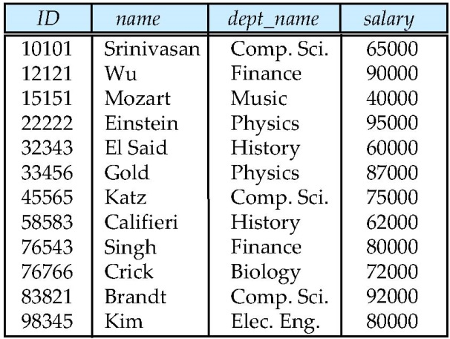
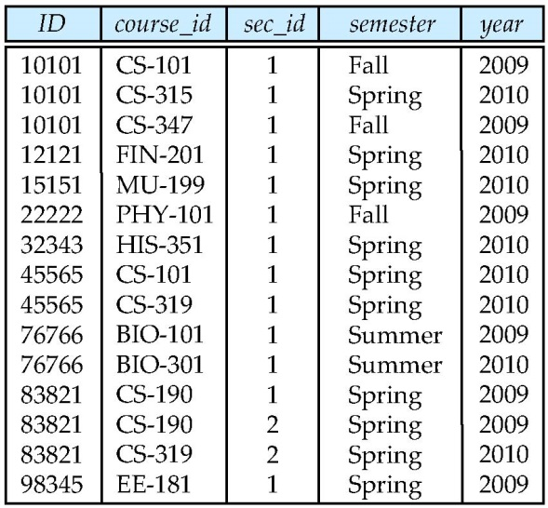
Relational algebra – Cartesian-product (2)
Example: the Cartesian product of the relations instructor and teaches is written as:
instructor X teaches
We construct a tuple of the result out of each possible pair of tuples: one from the instructor relation and one from the teaches relation (see next slide)
Since the instructor ID appears in both relations we distinguish between these attribute by attaching to the attribute the name of the relation from which the attribute originally came.
instructor.ID
teaches.ID
instructor
teaches

Slide 20
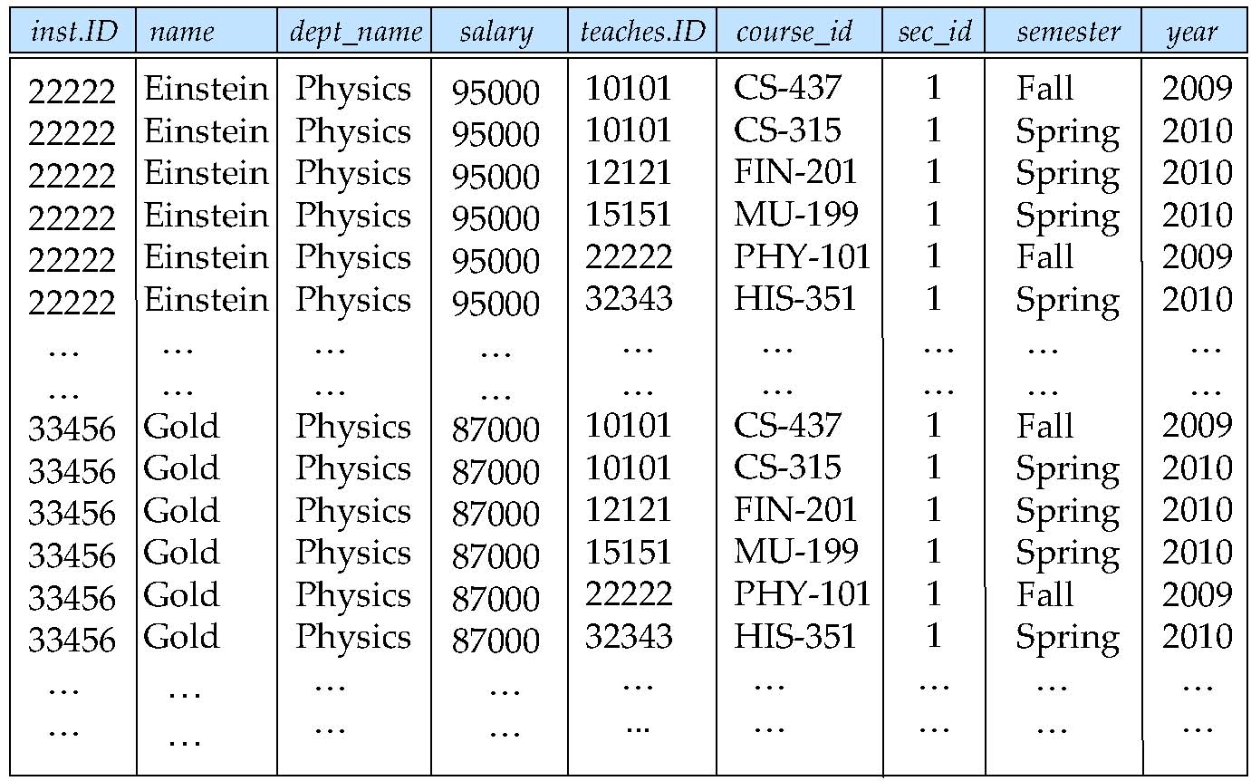
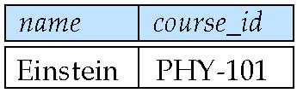
Relational algebra – query examples
Find the names of all instructors in the Physics department, along with the course_id of all courses they have taught
Query 1 ∏_{name,course_id} (σ_{instructor.ID=teaches.ID} (σ _{dept_name=“Physics”} (instructor x teaches)))
There is often more than one way to write a query in relational algebra
The following two queries are equivalent, i.e., they give the same result
Query 1 ∏_{name,course_id} (σ _{instructor.ID=teaches.ID} (σ _{dept_name=“Physics”} (instructor x teaches)))
Query 2 ∏_{name,course_id} (σ_{instructor.ID=teaches.ID} (σ _{dept_name=“Physics”} (instructor) x teaches))

Slide 21
Query optimization
Query optimization: the process of choosing a suitable execution strategy for processing a query.
A query, e.g., a SQL, first be scanned, parsed and validated
The scanner identifies the query tokens, e.g., the keywords, attribute names and relation names
The parser checks the query syntax
The validation checks that all attributes and relation names are valid

Slide 22
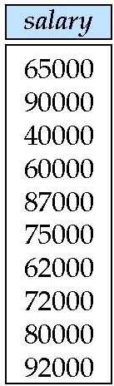
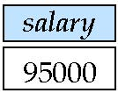
Relational algebra – rename
Allows us to name, and therefore to refer to, the results of relational-algebra expressions. Allows us to refer to a relation by more than one name.
The expression ρ_{x} (E) returns the result of expression E under the name X
If a relational-algebra expression E has arity n, then ρ_{x(A1,A2, .. An)} (E) returns the result of expression E under the name X, and with the attributes renamed to A₁ , A₂ , …., A_{n} .
Example: Find the highest salary in the university
Step 1: find instructor salaries that are less than some other instructor salary (i.e. not the highest). Using a copy of instructor under a new name d
∏_{instructor.salary} (σ _{instructor.salary < d.salary} (instructor x ρ_{d} (instructor)))
Step 2: Find the highest salary
∏_{salary} (instructor) – ∏_{instructor.salary} (σ _{instructor.salary < d.salary} (instructor x ρ_{d} (instructor)))

Slide 23
Relational algebra – additional operations (1)
Set-Intersection
The set-intersection operation allows us to find tuples that are in both the input relations.
Notation: r ∩ s
Assume:
r, s have the same arity
attributes of r and s are compatible
Note: r ∩ s = r – (r – s)

Slide 24
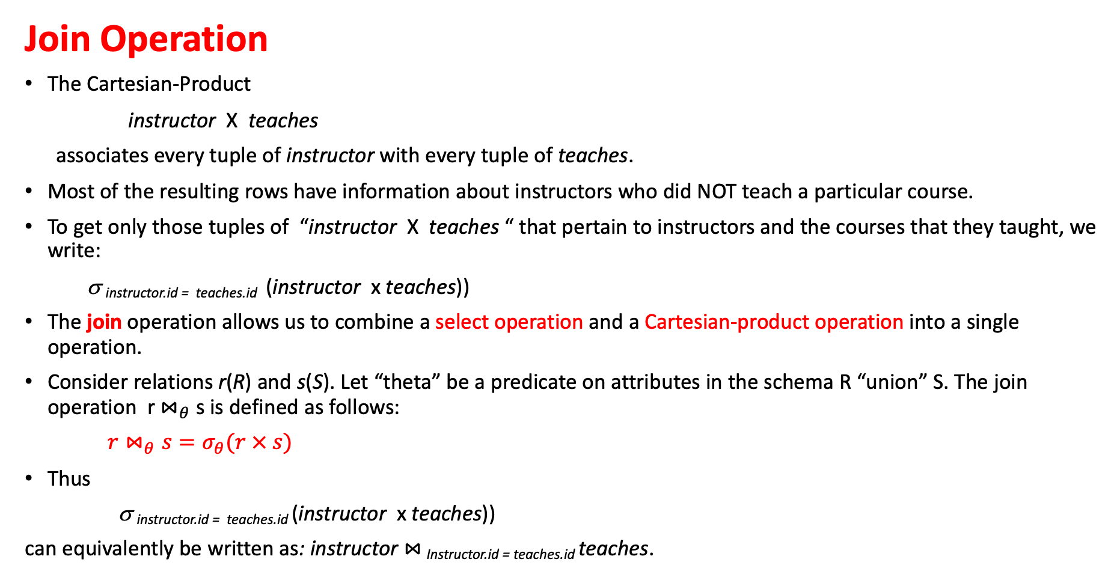
Relational algebra – additional operations (2)
Join Operation
The Cartesian-Product
instructor X teaches
associates every tuple of instructor with every tuple of teaches.
Most of the resulting rows have information about instructors who did NOT teach a particular course.
To get only those tuples of “instructor X teaches “ that pertain to instructors and the courses that they taught, we write:
σ _{instructor.id = teaches.id} (instructor x teaches))
The join operation allows us to combine a select operation and a Cartesian-product operation into a single operation.
Consider relations r(R) and s(S). Let “theta” be a predicate on attributes in the schema R “union” S. The join operation r $⋈_{θ}$ s is defined as follows:
$r⋈_{θ}s=σ_{θ}(r × s)$
Thus
σ _{instructor.id = teaches.id} (instructor x teaches))
can equivalently be written as: instructor $⋈_{ }$_{Instructor.id = teaches.id} teaches.

Slide 25
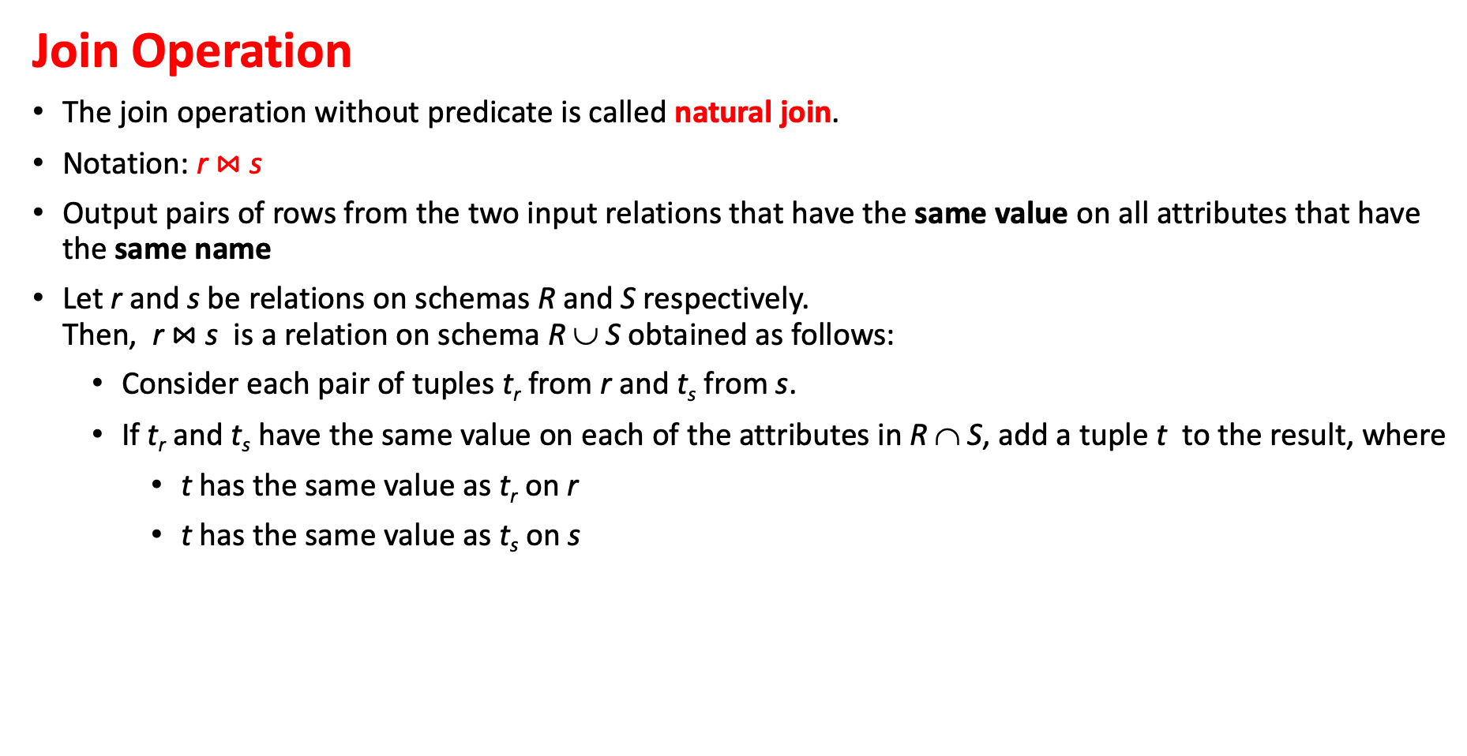
Relational algebra – additional operations (3)
Join Operation
The join operation without predicate is called natural join.
Notation: r $⋈$ s
Output pairs of rows from the two input relations that have the same value on all attributes that have the same name
Let r and s be relations on schemas R and S respectively. Then, r $⋈$ s is a relation on schema R ∪ S obtained as follows:
Consider each pair of tuples t_{r} from r and t_{s} from s.
If t_{r} and t_{s} have the same value on each of the attributes in R ∩ S, add a tuple t to the result, where
t has the same value as t_{r} on r
t has the same value as t_{s} on s

Slide 26
Relational algebra – additional operations (4)
Assignment Operation
It is convenient at times to write a relational-algebra expression by assigning parts of it to temporary relation variables.
The assignment operation is denoted by ← and works like assignment in a programming language.
Example: Find all instructor in the “Physics” and Music department. Physics ← σ _{dept_name=“Physics”} (instructor)
Music ← σ _{dept_name=“Music”} (instructor)
Physics ∪ Music
With the assignment operation, a query can be written as a sequential program consisting of
a series of assignments
followed by an expression whose value is displayed as a result of the query.

Slide 27
Relational algebra – additional operations (5)
Outer Join Operation
An extension of the join operation that avoids loss of information.
Computes the join and then adds tuples from one relation that does not match tuples in the other relation to the result of the join.
Uses null value to signify that the value is unknown or does not exist
Three forms of outer join:
left outer join
right outer join
full outer join

Slide 28
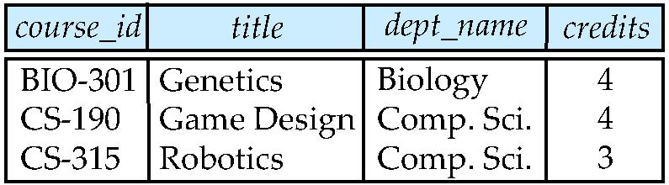
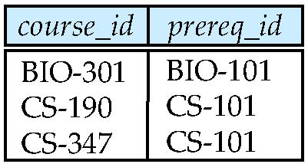
Relational algebra – additional operations (6)
Outer Join Operation
Relation course
Relation prereq
Observe that
CS-315 is missing in prereq and
CS-347 is missing in course

Slide 29
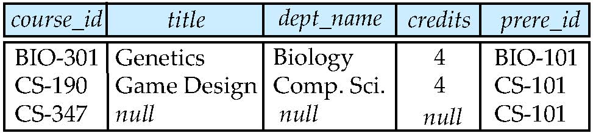
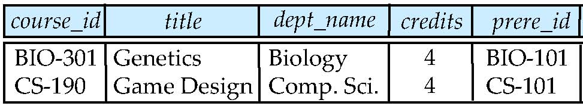
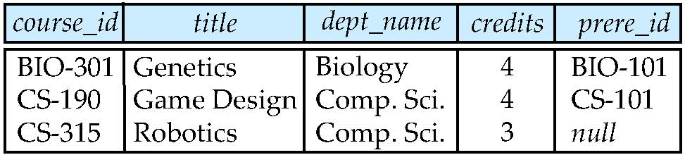
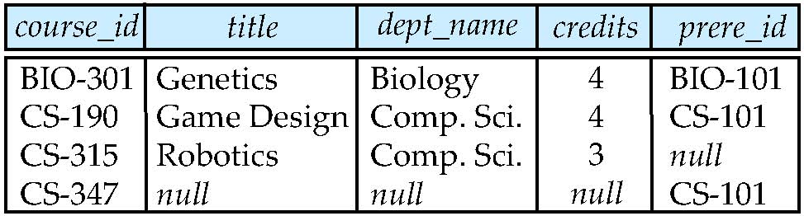

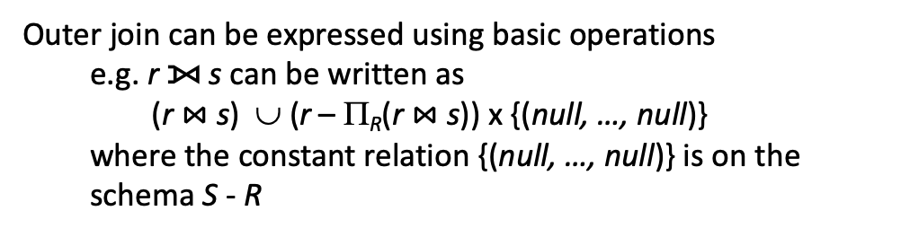
Relational algebra – additional operations (7)
Outer Join Operation
Join
course $⋈$ prereq
Right Outer Join
course ⟖ prereq
Left Outer Join
course ⟕ prereq
Full Outer Join
course ⟗ prereq
Outer join can be expressed using basic operations
e.g. r ⟕ s can be written as
(r $⋈$ s) ∪ (r – Π_{R}(r $⋈$ s)) x {(null, …, null)}
where the constant relation {(null, …, null)} is on the schema S - R

Slide 30
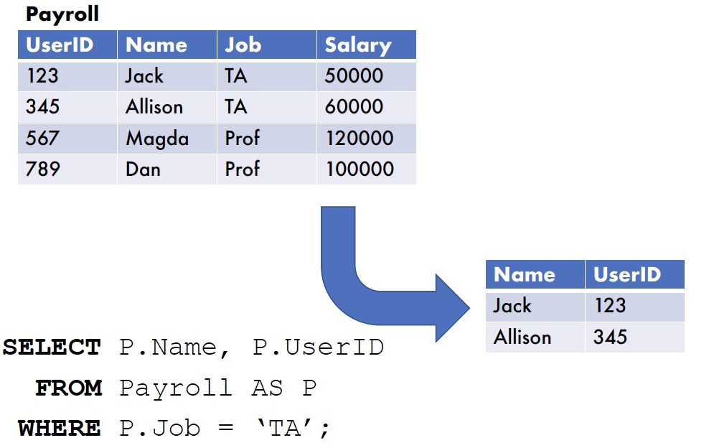
SQL – Select
Select <List of Columns and expressions (usually involving columns)>
From <List of Tables & Join Operators>
Where <List of Row conditions joined together by And, Or, Not>
Group By <list of grouping columns>
Having <list of group conditions connected by And, Or, Not >
Order By <list of sorting specifications>

Slide 31
SQL – conceptual evaluation
From Tables: Cross product and join operations
1
Restriction on where conditions
2
Compute
aggregates
and reduce
each group
to 1 row
Group By?
Sort on Group BY columns
Restriction
on HAVING
conditions
Yes
No
3
4
5
Order By?
Sort
columns in
ORDER BY
Yes
6
No
Project columns in SELECT
7

Slide 32
SQL – Order By
Used to sort the results based on contents of a column
Multiple levels of sort can be done by specifying multiple columns
An expression can be used in Order By clause
Syntax:
Select function(column)
From table1 [, table2 …]
[Where condition]
[Order By {Column | alias | position} [ASC | DESC]]

Slide 33
SQL – Order By
Example: Sort Movies by profits in Ascending order
Select Movie_title, Gross, Budget, (Gross – Budget) as profits
From movies
Order BY profits
Movie_title
Gross
Budget
Profit
Great Escape
67.5
70
-2.5
54
50
4
Upside Down
96
80
16
Green Warrior
28
7
21
Blue Oranges

Slide 34
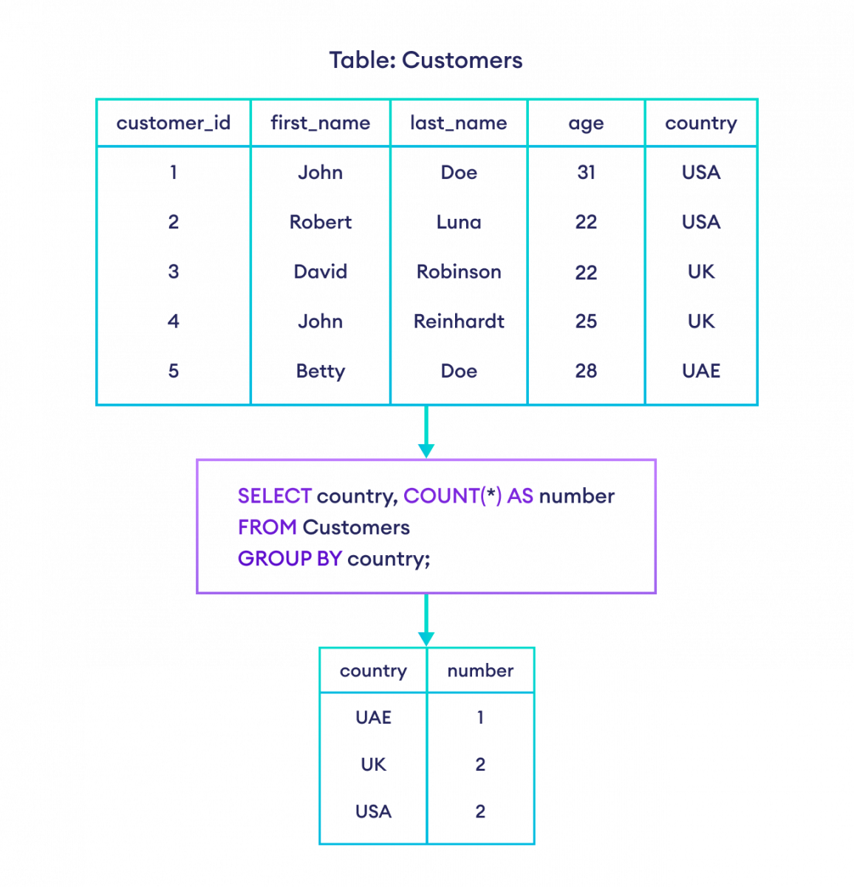
SQL – Group By
Categorizes the query results according to the contents of a column in the database .
Multiple levels of subgroups can be created by specifying multiple columns.
Syntax:
Select column1, [column2, …]
From table [, table …]
[Where condition]
Group By column1, [column2, ….]
Having [Condition]

Slide 35
SQL – Join
A Join is a Query that combines data from multiple tables
Multiple tables are specified in the From Clause
For two tables to be joined in a sensible manner, they need to have data in common
Example:
Schema: Movies (movie_title, director_id, release_date)
People(person_fname, person_lname, person_id)
Query: Select movie_title, person_fname, person_lname
From Movies, People
Where director_id = person_id

Slide 36
SQL – Joining Condition
For a useful Join query a joining condition is required
Defined in where clause as relationships between columns
Multiple conditions may be defined if multiple columns shared
More than two tables can be joined in a query
Example: Find people who live in same state as studio
Schema:
Studios(studio_id, studio_state, studio_name, studio_city)
People(person_fname, person_lname, person_id, person_state, person_city)
Query:
Select person_fname, person_lname, studio_name
From Movies, People
Where studio_city = person_city
AND studio_state = person_state

Slide 37
SQL – Self Join
Required to compare values within a single column
Need to define aliases for the table names
Example: Find actors living in the same state
Schema:
People(person_fname, person_lname, person_id, person_state, person_city)
Query:
Select p1.person_id, p1.person_fname, p1.person_lname, p1.person_state
From People p1, People p2
Where p1.person_state = p2.person_state
AND p1.person_id != p2.person_id
Note:
Distinct operator is critical because if there are more than two people from any state
each person will appear as many times as there are people from the state

Slide 38
SQL – Left/Right Join
Schema:
People(person_fname, person_lname, person_id, person_state, person_city)
Movies(movie_id, movie_title, director_id, studio_id)
Location(movie_id, city, state)
Query:
Select movie_title, city, state
From Movies Left Join Locations
On Movies.movie_id = Locations.movie_id
Select movie_title, person_fname, person_lname
From Movies Right Join People
On Movies.director_id = Person.person_id
Includes all
non matched
movie titles
Includes
all people
not matching
to directors

Slide 39
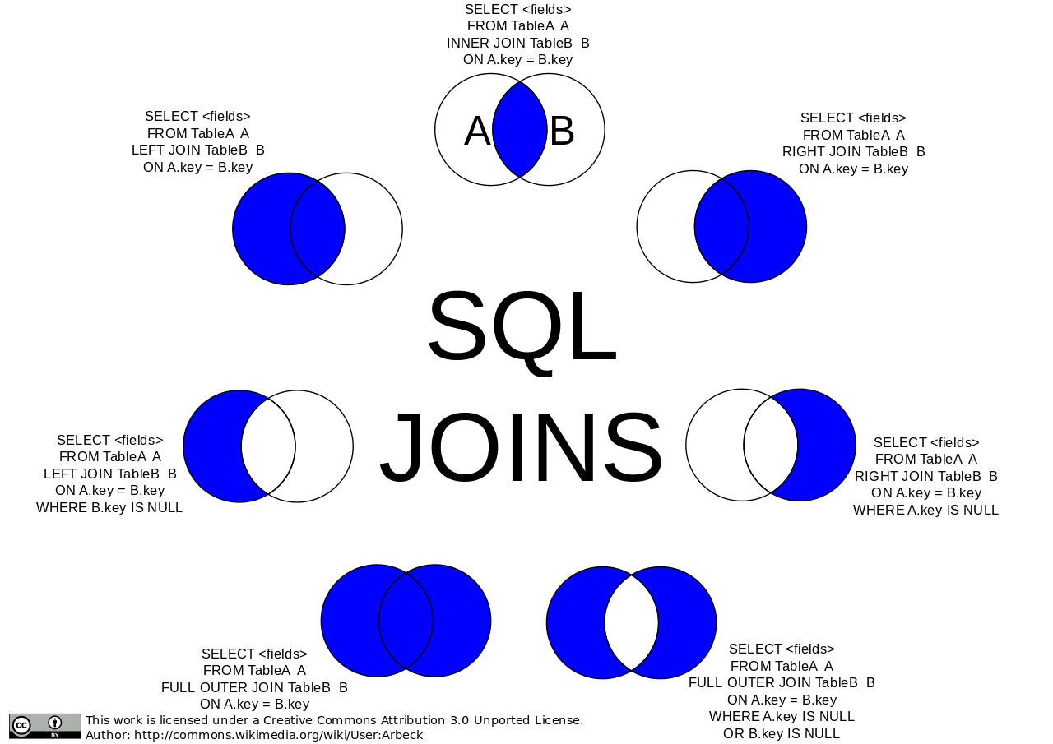
SQL – all Joins

Slide 40
SQL – Nested Queries
A sub query is a query nested within another query
The enclosing query also called outer query
Nested query is called inner query
There can be multiple levels of nesting
Example:
Select movie_title
From movies
Where director_id IN (
Select person_id
From People
Where person_state = ‘TX’)

Slide 41
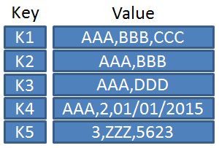
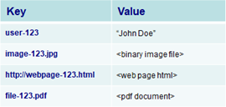
NoSQL querying – key-value data store
There is no schema and the value of the data can be just about anything. Values are identified and accessed via a key, and values can be numbers, strings, counters, JSON, XML, HTML, binaries, images, videos, and more.
E.g., shopping carts, session logs.
Keys can be queried. Values cannot be queried.
To query using some attribute of the value is not possible (in general). We need to read the value to test any query condition
No query language for key-value stores.
Solution:
Sorted keys: keys can be indexed first, and then searched.
Secondary keys/indices can be used, e.g., email addresses, telephone numbers, names, or contents from the value.
Example of key value database with keys mapping to different values and data types.

Slide 42
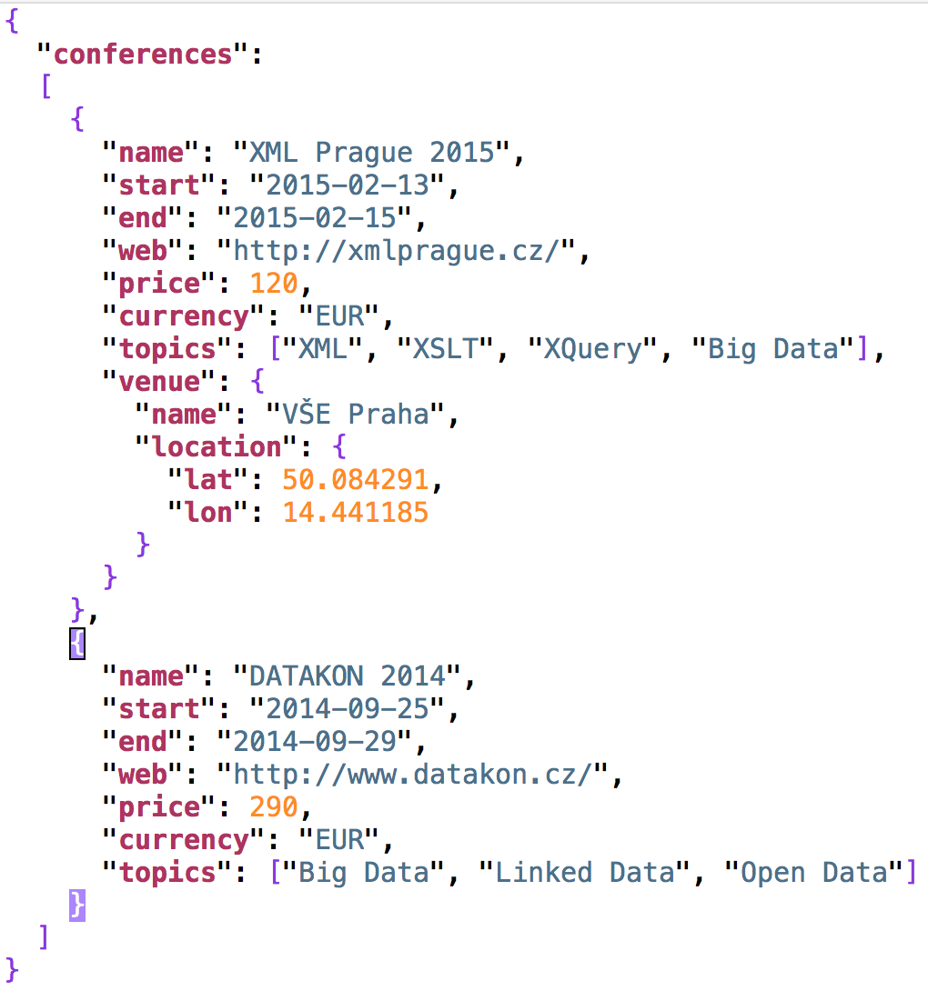
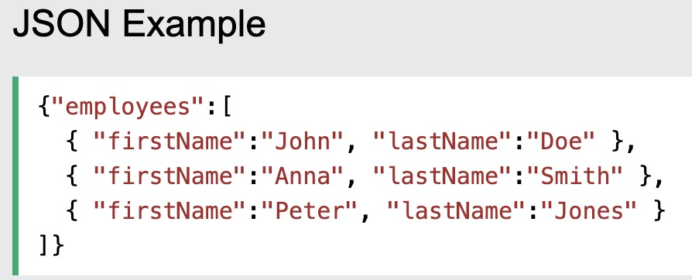
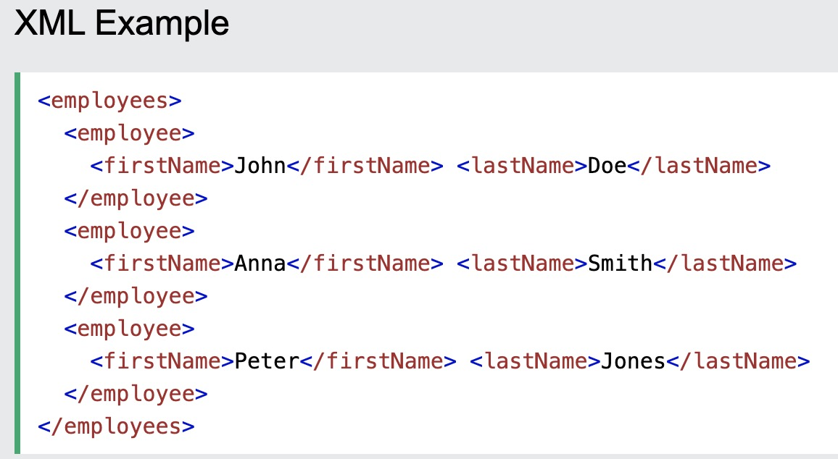
NoSQL querying – document databases (1)
Document databases
Structured text data - Hierarchical tree data structures
Typically JSON, XML, BSON (Binary JSON)
XML: Extensible Markup Language
Tags: XML tags are not predefined. You need to define your customized tags.
XML was designed to carry data, not to display that data
JSON: JavaScript Object Notation
object: an unordered set of name+value pairs,
syntax: { name: value, name: value, name: value, ...}
array: an ordered collection of values (elements),
syntax [ comma-separated values ]

Slide 43

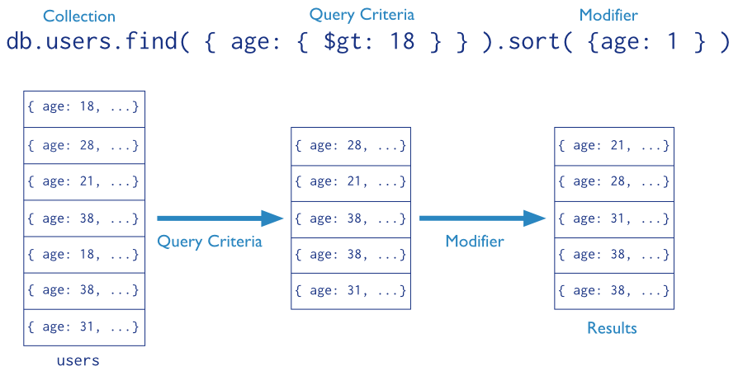
NoSQL querying – document databases (2)
E.g., MongoDB querying: Mongo query language
Targets a specific collection of documents
Specifies criteria that identify the returned documents
May include a projection to specify returned fields
May impose limits, sort, orders, …
Basic query - all documents in the collection:
db.users.find()
db.users.find( {} )
E.g.,
db.inventory.find({ type: "snacks" })
All documents from collection inventory where the type field has the value snacks
db.inventory.find({ type: { $in: [ 'food', 'snacks' ] } } )
All inventory docs where the type field is either food or snacks
db.inventory.find( { type: 'food', price: { $lt: 9.95 } } )
All ... where the type field is food and the price is less than 9.95

Slide 44
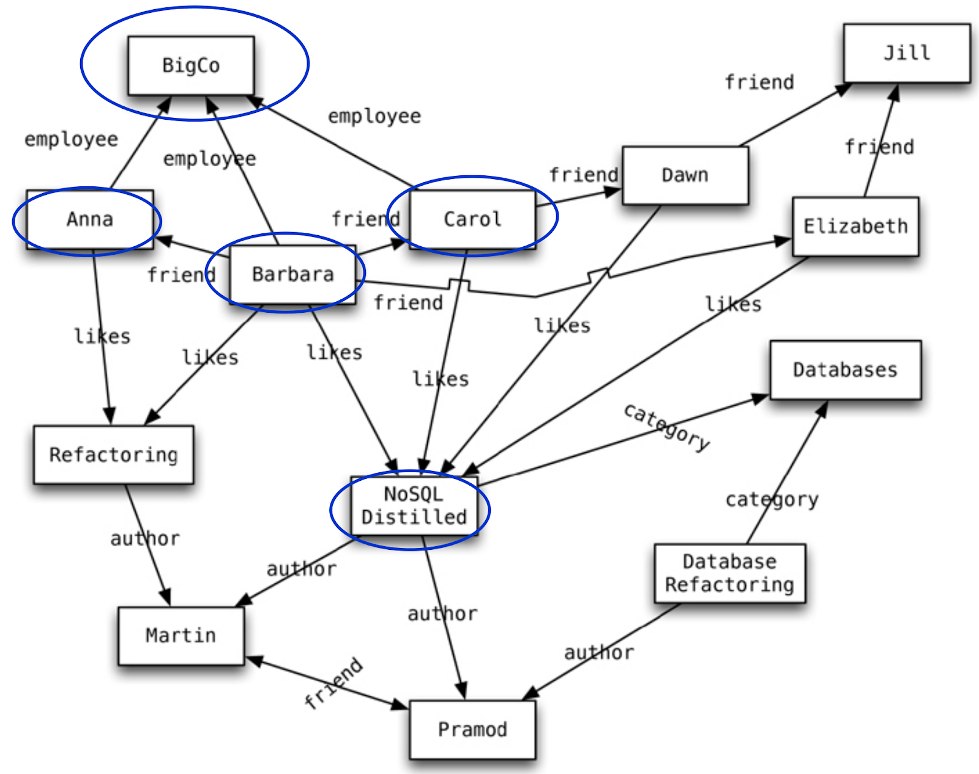
NoSQL querying – graph databases (1)
To store entities and relationships between them
Nodes are instances of objects
Nodes have properties, e.g., name
Edges connect nodes and have directional significance
Edges have types e.g., likes, friend, …
Nodes are organized by relationships
Allow to find interesting patterns
E.g., Get all nodes that are “employee” of “Big Company” and that “likes” “NoSQL Distilled”

Slide 45
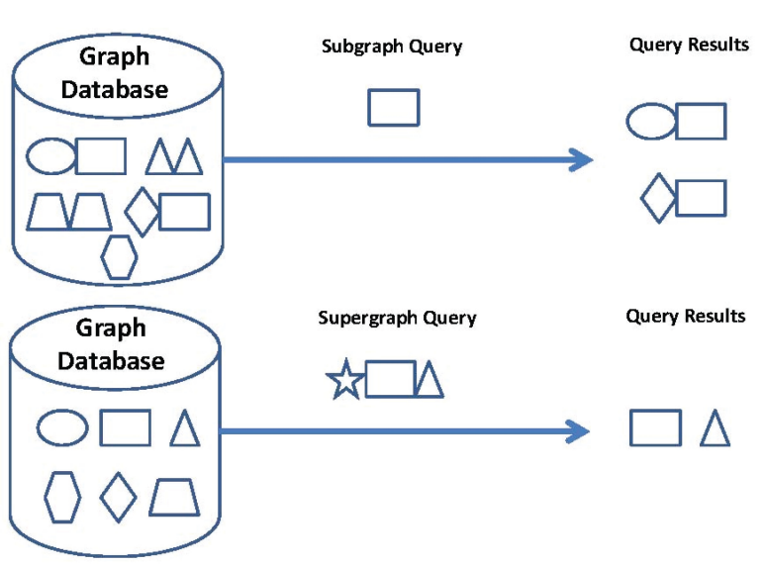
NoSQL querying – graph databases (2)
Subgraph queries
Searches for a specific pattern in the graph database
Query = a small graph
or a graph, where some parts are uncertain, e.g., vertices with wildcard labels
More general type: allow sub-graph isomorphism
Super-graph queries
Search for graphs whose whole structure is contained in the query graph
Similarity (approximate matching) queries
Finds graphs which are similar to a given query graph
but not necessarily isomorphic
Key question: how to measure the similarity
Cypher Language: Neo4j graph query language for querying and updating
MATCH: The graph pattern to match
WHERE: Filtering criteria
RETURN: What to return
START: Starting points in the graph by explicit index lookups or by node IDs (both deprecated)
WITH: Divides a query into multiple parts
CREATE: Creates nodes and relationships.
DELETE: Remove nodes, relationships, properties
SET: Set values to properties
MATCH (p: Person)
WHERE p.age >= 18 AND p.age < 30
RETURN p.name
(return names of all adult people under 30)
MATCH (user: Person {name: 'Andres'})-[:Friend]->(follower)
RETURN user.name, follower.name
(find all ‘Friends’ of 'Andres')

Slide 46

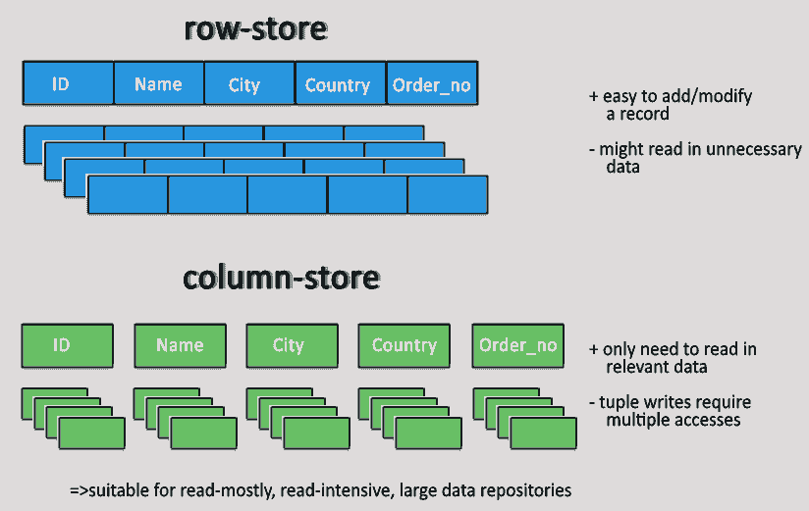
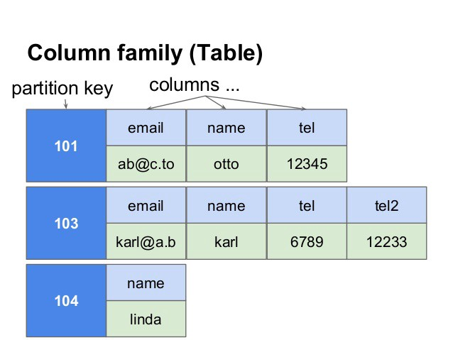
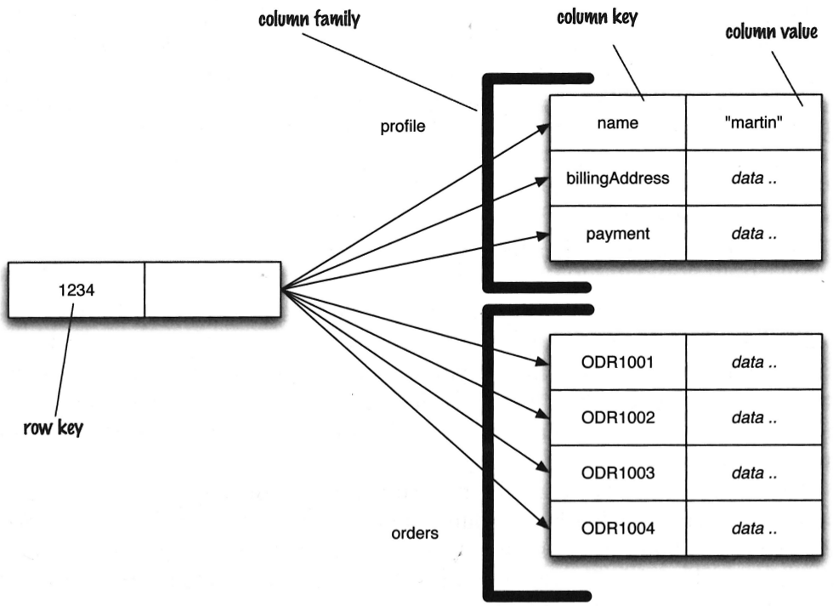
NoSQL querying – columnar databases
Column: the basic data item, column key-value pairs
Row: a collection of columns attached to row key
Columns can be added to any row at any time
without having to add it to other rows
E.g., Cassandra Query Language (CQL).
The syntax of CQL is similar to SQL
But search just in one table (no joins)
SELECT <selectExpr>
FROM [<keyspace>.]<table>
[WHERE <clause>]
[ORDER BY <clustering_colname> [DESC]]
[LIMIT m];
e.g.,
SELECT column_name, column_value
FROM mytable
WHERE row_id=3
ORDER BY column_value;

Slide 47
Thanks for your attention!

Slide 48
Appendix 1. https://www.sqltutorial.org/ 2. http://disa.fi.muni.cz/david-novak/teaching/nosql-databases-2018/lectures/ 3. https://www.oreilly.com/library/view/nosql-for-mere/9780134029894/

